Slide 1
Lecture 4. Stream Ciphers and Authenticated Encryption
CSE 1204 Applied Cryptography
Lectures by Zhaxalykov T.M.

Slide 2
Agenda
Stream Ciphers
Message Authentication Codes
The Need for Authenticated Encryption
Combining Encryption and Authentication
Authenticated Encryption with Associated Data (AEAD)
Modern AEAD Constructions

Slide 3
1.Stream Ciphers
1.1 Definition and Principles
1.2 The One-Time Pad: Perfect Security
1.3 RC4: A Cautionary Tale
1.4 ChaCha20: Modern Stream Cipher Design
1.5 Stream Ciphers vs. Block Cipher CTR Mode

Slide 4
1. Stream Ciphers
While block ciphers operate on fixed-size blocks, stream ciphers encrypt data bit-by-bit or byte-by-byte, making them ideal for streaming applications and situations where data length is unknown in advance.

Slide 5
1.1 Definition and Principles
Definition 1.1 (Stream Cipher): A stream cipher is a symmetric encryption algorithm that generates a pseudorandom keystream from a secret key and (typically) an initialization vector (IV) or nonce. The plaintext is encrypted by combining it with the keystream, usually through XOR operation: Cᵢ = Pᵢ ⊕ Kᵢ, where Kᵢ is the i-th keystream bit/byte.

Slide 6
1.1 Definition and Principles
Key Properties:
Arbitrary Length: Can encrypt messages of any length without padding.
Efficiency: Often faster than block ciphers in software implementations.(Less operation per bit/byte)
State-Based: Maintain internal state that evolves as keystream is generated.
Synchronous vs. Self-Synchronizing: Most modern stream ciphers are synchronous (keystream depends only on key and IV, not plaintext/ciphertext).

Slide 7
1.2 The One-Time Pad: Perfect Security
The theoretical foundation for stream ciphers is the one-time pad (OTP), proven by Claude Shannon to provide perfect secrecy.
Theorem 1.1 (Shannon's Perfect Secrecy): The one-time pad, where plaintext is XORed with a truly random key of equal length used only once, provides information-theoretic security.
However, OTP is impractical: it requires keys as long as messages and keys cannot be reused. Stream ciphers approximate OTP by using a pseudorandom keystream generator seeded with a short key.

Slide 8
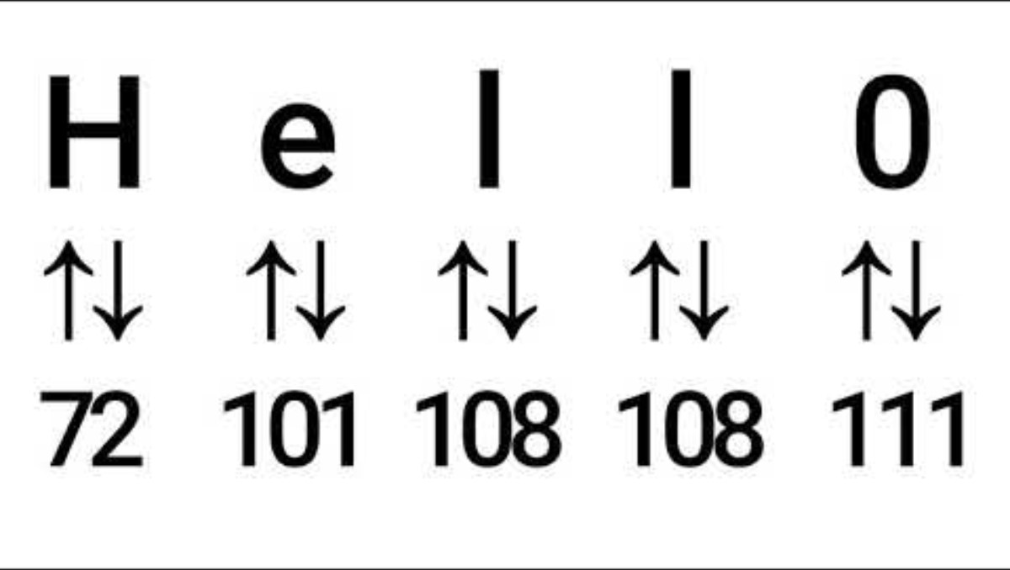

Slide 9
1.3 RC4: A Cautionary Tale
RC4 (Rivest Cipher 4), designed by Ron Rivest in 1987, was one of the most widely deployed stream ciphers, used in SSL/TLS and WEP wireless security. Its history illustrates the importance of rigorous cryptanalysis.

Slide 10
1.3 RC4: A Cautionary Tale
Algorithm Overview:
RC4 maintains a permutation of 256 bytes (state array S) and two indices (i, j). Key scheduling initializes S based on the key. Keystream generation involves:
Increment i: i = (i + 1) mod 256
Update j: j = (j + S[i]) mod 256
Swap: S[i] ↔ S[j]
Output: K = S[(S[i] + S[j]) mod 256]

Slide 11
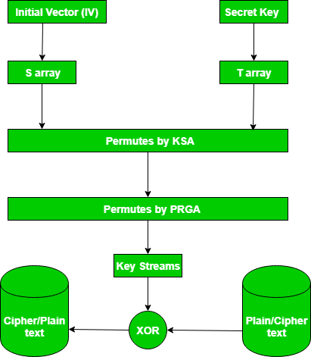

Slide 12
1.3 RC4: A Cautionary Tale
Vulnerabilities Discovered:
Weak Keys: Certain keys produce biased keystreams.
Initial Keystream Bias: First bytes of keystream are not uniformly random; best practice is to discard the first 256-3072 bytes.
Related-Key Attacks: When IV and key are concatenated (as in WEP), related keys produce correlated keystreams.
Statistical Biases: Long-term biases in keystream enable distinguishing attacks and plaintext recovery in protocols like WEP and TLS.
Practical Attacks: The BEAST and RC4 NoMore attacks broke TLS when using RC4.
Status: RC4 is deprecated and must not be used in new systems. IETF prohibited RC4 in TLS (RFC 7465, 2015).
Обнаружены уязвимости:
Слабые ключи: некоторые ключи приводят к смещению потоков ключей.
Смещение начального потока ключей: первые байты потока ключей не являются равномерно случайными; рекомендуется отбрасывать первые 256-3072 байта.
Атаки с использованием связанных ключей: Когда IV и key объединяются (как в WEP), связанные ключи создают коррелированные потоки ключей.
Статистические погрешности: Долгосрочные погрешности в потоке ключей позволяют распознавать атаки и восстанавливать открытый текст в таких протоколах, как WEP и TLS.
Практические атаки: Атаки BEAST и RC4 NoMore нарушали протокол TLS при использовании RC4.
Статус: RC4 устарел и не должен использоваться в новых системах. IETF запретил использование RC4 в TLS (RFC 7465, 2015).

Slide 13
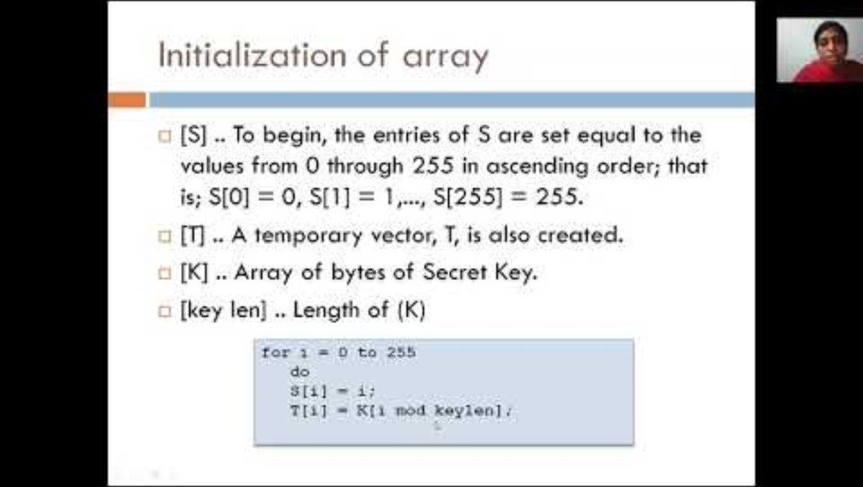

Slide 14
1.4 ChaCha20: Modern Stream Cipher Design
ChaCha20, designed by Daniel J. Bernstein, represents modern stream cipher design principles: simplicity, high performance in software, strong security guarantees, and extensive analysis.
Design Philosophy:
Simple Operations: Uses only addition (mod 2³²), XOR, and rotation—no S-boxes or lookup tables.
ARX Structure: Addition-Rotation-XOR operations provide strong diffusion and are resistant to timing attacks.
Constant-Time: No secret-dependent branches or memory accesses, immune to cache-timing attacks.
High Performance: Achieves 3-4 GB/s on modern CPUs, competitive with AES-NI hardware acceleration.

Slide 15
1.4 ChaCha20: Modern Stream Cipher Design
ChaCha20 operates on a 512-bit state (16 32-bit words) initialized from:
Constants: 4 words of fixed constants ('expand 32-byte k')
Key: 8 words (256 bits)
Counter: 1 word (32 bits, allows encrypting 256 GB per nonce)
Nonce: 3 words (96 bits)

Slide 16
1.4 ChaCha20: Modern Stream Cipher Design
The QuarterRound function applies to four words (a, b, c, d):
a += b; d XOR a; d <<<= 16; // Addition, XOR, rotation by 16 bits
c += d; b XOR c; b <<<= 12;
a += b; d XOR a; d <<<= 8;
c += d; b XOR c; b <<<= 7;
Twenty rounds (10 double rounds) apply QuarterRound to all column and diagonal combinations, thoroughly mixing the state. The final state is added to the initial state and output as 512 bits of keystream.

Slide 17
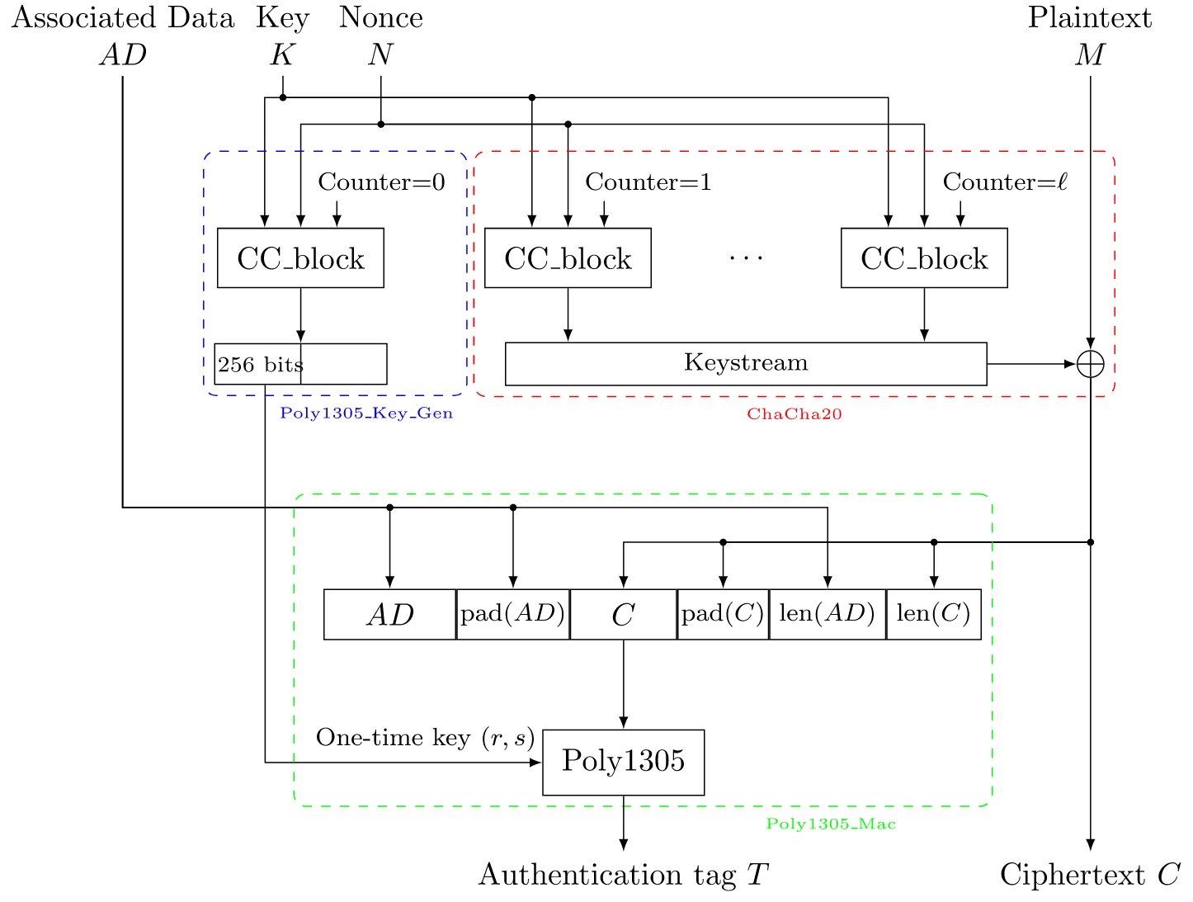

Slide 18
1.4 ChaCha20: Modern Stream Cipher Design
Security Properties:
No Known Attacks: After 15+ years of analysis, no practical attacks on full 20-round ChaCha20 exist.
Large Margin: Even 12 rounds appear secure; 20 rounds provide substantial security margin.
Nonce-Based: Requires unique nonce per key, like CTR mode.
Adoption: ChaCha20 is widely deployed in TLS 1.3, WireGuard VPN, mobile applications (Google Android full-disk encryption), and as an alternative to AES when hardware acceleration is unavailable.

Slide 19
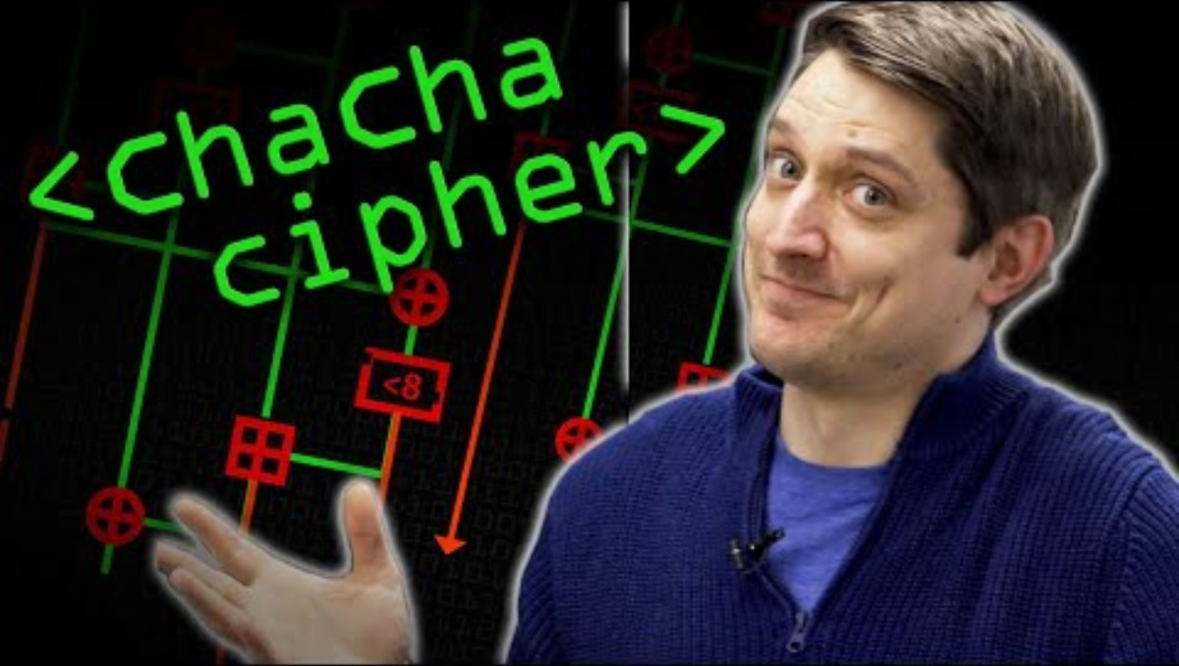

Slide 20
1.5 Stream Ciphers vs. Block Cipher CTR Mode
Dedicated Stream Ciphers (e.g., ChaCha20):
Software Performance: Often faster than block ciphers on platforms without AES hardware acceleration.
Simplicity: Typically simpler designs with fewer components.
Side-Channel Resistance: Constant-time operations by design.
Block Cipher CTR Mode (e.g., AES-CTR):
Hardware Acceleration: AES-NI instructions provide 5-10 GB/s throughput on modern Intel/AMD CPUs.
Standardization: AES has longer history and broader standardization.
Reuse: Block cipher can be used in multiple modes (CBC, GCM, etc.).
Recommendation: Use AES-GCM on platforms with AES-NI; use ChaCha20-Poly1305 on mobile and embedded systems without hardware acceleration.

Slide 21
2.Message Authentication Code
2.1 Definition and Security Goals
2.2 HMAC: Hash-Based MAC
2.3 Timing Attacks on MAC Verification

Slide 22
2. Message Authentication Codes
Encryption alone provides only confidentiality, not integrity or authenticity. An adversary can modify ciphertexts in meaningful ways without detection. Message Authentication Codes (MACs) address this critical gap.

Slide 23
2.1 Definition and Security Goals
Definition 2.1 (Message Authentication Code): A MAC is a symmetric cryptographic primitive consisting of three algorithms: (1) Tag generation: T = MAC_k(M) produces a fixed-length tag T for message M under key k. (2) Verification: Verify_k(M, T) returns accept if T is valid for M, reject otherwise. (3) Key generation: Generates secret key k.
Security Property (Existential Unforgeability):
Definition 2.2 (EUF-CMA Security): A MAC is existentially unforgeable under chosen-message attack (EUF-CMA) if no efficient adversary, after obtaining valid tags for messages of its choice, can produce a valid tag for any new message with non-negligible probability.
This definition captures that an adversary cannot forge a valid tag even after seeing many message-tag pairs, and even if they can choose which messages to see tags for.
Определение 2.1 (Код аутентификации сообщения): MAC - это симметричный криптографический примитив, состоящий из трех алгоритмов: (1) Генерация тега: T = MAC_k(M) создает тег фиксированной длины T для сообщения M с ключом k. (2) Проверка: Verify_k(M, T) возвращает значение accept, если T допустимо для M, и отклоняет в противном случае. (3) Генерация ключа: Генерирует секретный ключ k.
Свойство безопасности (экзистенциальная непроницаемость):
Определение 2.2 (Безопасность EUF-CMA): MAC-адрес является экзистенциально неуязвимым при атаке с использованием выбранных сообщений (EUF-CMA), если ни один эффективный злоумышленник, получив допустимые теги для сообщений по своему выбору, не может создать допустимый тег для любого нового сообщения с вероятностью, которой нельзя пренебречь.
Это определение отражает то, что злоумышленник не может подделать действительный тег, даже просмотрев множество пар тегов сообщений, и даже если он может выбирать, для каких сообщений видеть теги.

Slide 24
2.2 HMAC: Hash-Based MAC
HMAC (Hash-based Message Authentication Code), specified in RFC 2104, is the most widely used MAC construction, building MACs from cryptographic hash functions.
Construction:
HMAC_k(M) = H((k ⊕ opad) || H((k ⊕ ipad) || M))
Where:
H: Cryptographic hash function (e.g., SHA-256, SHA-3)
k: Secret key (padded to hash block size if necessary)
ipad: Inner padding constant (0x36 repeated)
opad: Outer padding constant (0x5C repeated)
||: Concatenation operator

Slide 25
Example 2.1: HMAC-SHA256
Key: k = 0x0b0b0b0b0b0b0b0b0b0b0b0b0b0b0b0b (128 bits)
Message: M = 'Hello, World!'
Step 1: Compute inner hash = SHA256((k ⊕ ipad) || M)
Step 2: Compute outer hash = SHA256((k ⊕ opad) || inner_hash)
HMAC-SHA256 output: 32-byte tag

Slide 26
2.2 HMAC: Hash-Based MAC. Why Not Simply H(k || M)?
Naive constructions like H(k || M) or H(M || k) are vulnerable to attacks:
Length Extension Attack: For Merkle-Damgård hashes (SHA-256, SHA-1), knowing H(M) allows computing H(M || M') without knowing the key, enabling tag forgery.
HMAC's nested structure prevents this: the adversary cannot extend the inner hash without knowing the key used in the outer hash.
Security: HMAC is provably secure under the assumption that the underlying hash function's compression function is a pseudorandom function (PRF). No practical attacks on HMAC-SHA256 or HMAC-SHA3 exist

Slide 27
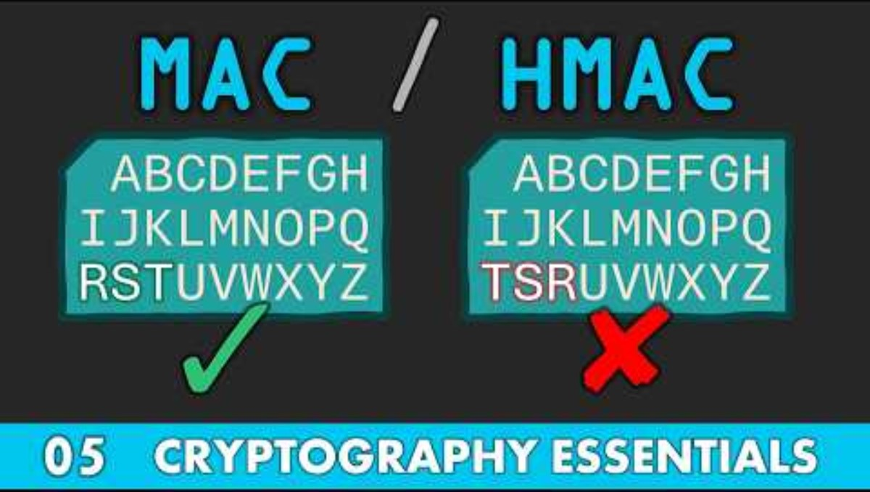

Slide 28
2.3 Timing Attacks on MAC Verification
A critical implementation vulnerability: naive tag comparison reveals information through timing.
Vulnerable Code (Pseudocode):
function verify(computed_tag, received_tag):
for i = 0 to length(computed_tag):
if computed_tag[i] != received_tag[i]:
return INVALID # Early exit leaks position of first mismatch!

Slide 29
2.3 Timing Attacks on MAC Verification
Attack: By measuring verification time, an adversary determines which bytes are correct, enabling byte-by-byte tag forgery. With 256 attempts per byte, a 16-byte tag is forgeable in ~4,000 attempts instead of 2¹²⁸.

Slide 30
2.3 Timing Attacks on MAC Verification
Mitigation: Constant-Time Comparison:
function constant_time_compare(a, b):
result = 0
for i = 0 to length(a):
result |= a[i] ^ b[i] # Always iterate through all bytes
return (result == 0)
This ensures verification time is independent of the position of differences, preventing timing attacks. All modern cryptographic libraries provide constant-time comparison functions.

Slide 31
3.The Need for Authenticated Encryption
3.1 Why Encryption Alone is Insufficient
3.2 Active vs. Passive Adversaries

Slide 32
3. The Need for Authenticated Encryption
Encryption provides confidentiality. MACs provide integrity and authenticity. Most applications require both. However, combining them incorrectly leads to vulnerabilities.

Slide 33
3.1 Why Encryption Alone is Insufficient
Example 3.1: Bit-Flipping Attack on Unauthenticated Encryption
Consider a banking application using CTR mode to encrypt: 'Transfer $100 to Alice'. The ciphertext is transmitted to the bank.
Attack: An adversary intercepts the ciphertext and flips specific bits to change the plaintext to 'Transfer $999 to Alice'. Because CTR mode XORs plaintext with keystream, flipping ciphertext bits directly flips plaintext bits:
Original: P = 'Transfer $100'
Ciphertext: C = P ⊕ K (where K is keystream)
Adversary flips bits in C to create C' = C ⊕ Δ
Decryption: P' = C' ⊕ K = (C ⊕ Δ) ⊕ K = P ⊕ Δ = 'Transfer $999'
Without authentication, the bank accepts the modified message as valid. The adversary has successfully tampered with the transaction without knowing the key.

Slide 34
3.2 Active vs. Passive Adversaries
Passive Adversary: Observes ciphertexts but does not modify them. Encryption with IND-CPA security defends against passive adversaries.
Active Adversary: Can intercept, modify, delete, replay, or inject ciphertexts. Real-world adversaries are active. Authentication is essential to detect tampering.

Slide 35
4.Combinig Encryption and Authentication
4.1 Encrypt-and-MAC (E&M)
4.2 MAC-then-Encrypt (MtE)
4.3 Encrypt-then-MAC (EtM)

Slide 36
4. Combining Encryption and Authentication
There are three generic approaches to combining encryption and authentication, with vastly different security properties.

Slide 37
4.1 Encrypt-and-MAC (E&M)
C = Enc(K_enc, M)
T = MAC(K_mac, M)
Output: (C, T)
Security Analysis: Encrypt-and-MAC computes the MAC over the plaintext, which can leak information. If the MAC is deterministic, identical plaintexts produce identical MACs, revealing patterns similar to ECB mode. This violates IND-CPA security.
Example Failure: SSH historically used Encrypt-and-MAC, leading to plaintext recovery attacks.
Verdict: Insecure. Do not use.

Slide 38
4.2 MAC-then-Encrypt (MtE)
T = MAC(K_mac, M)
C = Enc(K_enc, M || T)
Output: C
Security Analysis: MAC-then-Encrypt includes the MAC in the encryption. While this can be secure with certain encryption schemes, it is vulnerable when combined with CBC mode and padding.
Attack: Padding Oracle on MAC-then-Encrypt with CBC: An adversary can distinguish between invalid padding and invalid MAC, enabling plaintext recovery through padding oracle attacks. Even though the MAC protects integrity, padding errors are revealed before MAC verification.
Example Failure: TLS 1.0-1.2 used MAC-then-Encrypt with CBC, leading to Lucky Thirteen and POODLE attacks.
Verdict: Potentially insecure depending on mode. Generally avoid.

Slide 39
4.3 Encrypt-then-MAC (EtM)
C = Enc(K_enc, M)
T = MAC(K_mac, C)
Output: (C, T)
Security Analysis: Encrypt-then-MAC computes the MAC over the ciphertext. The receiver verifies the MAC before decrypting. Invalid ciphertexts are rejected immediately, preventing padding oracle and other decryption-based attacks.
Theorem 4.1: If the encryption scheme is IND-CPA secure and the MAC is EUF-CMA secure, then Encrypt-then-MAC provides IND-CCA security (security against chosen-ciphertext attacks).
Proof Sketch: Any tampered ciphertext is detected by MAC verification failure before decryption, preventing the adversary from gaining information from decryption. The encryption provides confidentiality, and the MAC ensures that only validly-generated ciphertexts are decrypted.
Example Success: IPsec uses Encrypt-then-MAC.
Verdict: Secure. This is the recommended approach for generic composition.

Slide 40
5. Authenticated Encryption with Associated Data (AEAD)
5.1 AEAD Definition
5.2 Security Goals for AEAD

Slide 41
5. Authenticated Encryption with Associated Data (AEAD)
Authenticated Encryption with Associated Data (AEAD) is a modern cryptographic primitive that provides confidentiality, integrity, and authenticity in a single operation. AEAD modes are designed to be misuse-resistant and efficient.

Slide 42
5.1 AEAD Definition
Definition 5.1 (AEAD): An AEAD scheme consists of two algorithms:
Encryption: (C, T) = AEAD_Encrypt(K, N, M, A) where K is the key, N is nonce, M is plaintext, A is associated data (authenticated but not encrypted), C is ciphertext, T is authentication tag.
Decryption: M = AEAD_Decrypt(K, N, C, T, A) returns plaintext M if tag is valid, or ⊥ (rejection) if authentication fails.

Slide 43
5.1 AEAD Definition
Associated Data (A): Data that must be authenticated but not encrypted, such as packet headers, protocol metadata, or identifiers. A is included in the authentication tag computation but transmitted in plaintext.
Example Use Case: In a network packet, the header (source/destination addresses) must be readable by routers but must not be tampered with. The header is associated data; the payload is encrypted.

Slide 44
5.2 Security Goals for AEAD
IND-CCA Security: Indistinguishability under chosen-ciphertext attack. Even if adversary can decrypt chosen ciphertexts, they cannot distinguish encryptions.
INT-CTXT Security: Integrity of ciphertexts. Adversary cannot produce any valid ciphertext not previously generated by the encryption algorithm.
Associated Data Authentication: Any modification to associated data must be detected and cause decryption to fail.
Безопасность IND-CCA: Неразличимость при атаке с использованием выбранного зашифрованного текста. Даже если злоумышленник может расшифровать выбранный зашифрованный текст, он не может распознать шифрование.
Безопасность INT-CTXT: целостность зашифрованных текстов. Злоумышленник не может выдать какой-либо действительный зашифрованный текст, который ранее не был сгенерирован алгоритмом шифрования.
Проверка подлинности связанных данных: Любая модификация связанных данных должна быть обнаружена и привести к сбою расшифровки.

Slide 45
6. Modern AEAD Constructions
6.1 AES-GCM: Galois/Counter Mode
6.2 ChaCha20-Poly1305

Slide 46
6.1 AES-GCM: Galois/Counter Mode
AES-GCM (Galois/Counter Mode) is the most widely deployed AEAD mode, standardized by NIST and used in TLS 1.2/1.3, IPsec, SSH, and many other protocols.
Construction: GCM combines CTR mode encryption with GMAC (Galois Message Authentication Code) for authentication.

Slide 47
6.1 AES-GCM: Galois/Counter Mode
Encryption Process:
Generate Authentication Subkey: H = AES_K(0¹²⁸) - a fixed value derived from the key.
CTR Mode Encryption: Generate keystream using AES in counter mode with the nonce. Encrypt plaintext: C = M ⊕ Keystream.
GMAC Authentication: Compute authentication tag over associated data A and ciphertext C using polynomial evaluation in GF(2¹²⁸) with H as the key.
Tag Encryption: Encrypt the GMAC tag with a unique counter value to produce the final authentication tag T.

Slide 48
6.1 AES-GCM: Galois/Counter Mode
Mathematical Details (GMAC): GMAC uses polynomial multiplication in GF(2¹²⁸). Associated data and ciphertext blocks are treated as coefficients of a polynomial, which is evaluated at H (the authentication subkey). This construction provides both efficiency and provable security.

Slide 49
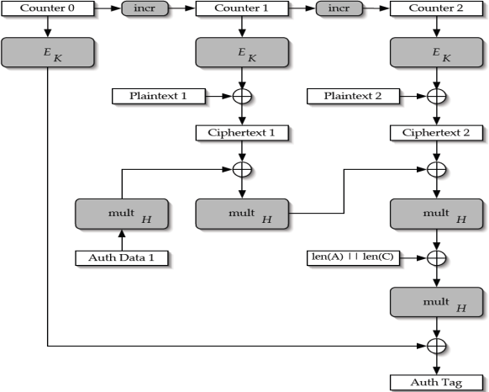

Slide 50
6.1 AES-GCM: Galois/Counter Mode
Advantages:
Parallelizable: Both encryption and authentication can be parallelized, enabling high throughput on modern hardware.
Hardware Acceleration: Intel PCLMULQDQ instructions accelerate GMAC computation; combined with AES-NI, GCM achieves 5-10 GB/s.
Widespread Adoption: Supported by virtually all cryptographic libraries and protocols.
Disadvantages:
Nonce Reuse is Catastrophic: Reusing a nonce with the same key completely breaks authentication and reveals plaintext XOR.
Authentication Strength: GMAC's polynomial construction provides 128-bit security only if nonces are never reused. A single nonce reuse leaks the authentication key H.
Software Performance Without Acceleration: On platforms without PCLMULQDQ, GCM can be slower than alternatives.
Usage: AES-GCM requires a 96-bit nonce (12 bytes) which must never be reused. Recommended: use a counter or random nonce with a 64-bit counter. Maximum 2³² blocks (64 GB) per nonce.

Slide 51
6.2 ChaCha20-Poly1305
ChaCha20-Poly1305, standardized in RFC 8439, combines the ChaCha20 stream cipher with the Poly1305 MAC to provide AEAD functionality. It is the preferred alternative to AES-GCM on platforms without AES hardware acceleration.

Slide 52
6.2 ChaCha20-Poly1305
Construction:
ChaCha20 Encryption: Generate keystream using ChaCha20 with key and nonce. Encrypt plaintext: C = M ⊕ Keystream.
Derive Poly1305 Key: Use the first 256 bits of ChaCha20 keystream (counter=0) as the one-time Poly1305 key.
Poly1305 MAC: Compute authentication tag over associated data A and ciphertext C using Poly1305 with the derived key.

Slide 53
6.2 ChaCha20-Poly1305
Poly1305 MAC: Poly1305 is a MAC that evaluates a polynomial modulo 2¹³⁰-5, providing 128-bit security. It is designed for high performance in software and produces a 128-bit (16-byte) tag.

Slide 55
6.2 ChaCha20-Poly1305
Advantages:
Excellent Software Performance: ChaCha20-Poly1305 is typically 2-3× faster than AES-GCM on platforms without AES-NI.
Constant-Time: Both ChaCha20 and Poly1305 are designed for constant-time implementation, resistant to timing attacks.
Simple Construction: Easier to implement securely than GCM.
Wide Deployment: Used in TLS 1.3, WireGuard, OpenSSH, Google Chrome, Android.
Disadvantages:
Nonce Reuse Catastrophic: Like GCM, nonce reuse breaks both confidentiality and authenticity.
Less Hardware Acceleration: Fewer processors have dedicated ChaCha20 acceleration compared to AES.
Usage: ChaCha20-Poly1305 uses a 96-bit (12-byte) nonce. Like GCM, the nonce must never be reused with the same key.

Slide 56
7. Conclusion
This lecture has completed our study of symmetric cryptography by addressing authentication and the critical need to combine encryption with integrity protection. Key insights include:
Stream ciphers provide an alternative to block ciphers, with ChaCha20 representing modern design principles emphasizing simplicity and software performance.
Message Authentication Codes (MACs) provide integrity and authenticity. HMAC is the standard construction for hash-based MACs.
Encryption alone is insufficient against active adversaries. Authentication is essential to prevent tampering.
When manually combining encryption and authentication, Encrypt-then-MAC is the only secure generic composition.
AEAD modes (AES-GCM, ChaCha20-Poly1305) provide integrated authenticated encryption, designed to be efficient and resistant to misuse.
Nonce management is critical in all modern symmetric systems. Nonce reuse completely breaks security.

Slide 57
7.2 Looking Forward
Next Section (Weeks 5-7): Cryptographic Hash Functions. We will study hash function design, security properties (collision resistance, preimage resistance), modern hash functions (SHA-256, SHA-3, BLAKE2), and applications including password hashing, digital signatures, and Merkle trees.

Slide 58
7.3 Preparation for Next Lecture
Read Ferguson et al., Chapter 5: Hash Functions
Read Aumasson, Chapter 6: Hash Functions
Review: Birthday paradox, collision probability
Lab 1 Colloquium: Prepare to discuss your symmetric cipher implementation.

Slide 59
References
Aumasson, J.-P. (2018). Serious cryptography: A practical introduction to modern encryption. No Starch Press.
Bellare, M., & Namprempre, C. (2000). Authenticated encryption: Relations among notions and analysis of the generic composition paradigm. In Advances in Cryptology—ASIACRYPT 2000 (pp. 531-545). Springer.
Bernstein, D. J. (2008). ChaCha, a variant of Salsa20. State of the Art of Stream Ciphers Workshop.
Ferguson, N., Schneier, B., & Kohno, T. (2010). Cryptography engineering: Design principles and practical applications. Wiley Publishing, Inc.
Krawczyk, H., Bellare, M., & Canetti, R. (1997). HMAC: Keyed-hashing for message authentication (RFC 2104).
McGrew, D. A., & Viega, J. (2004). The security and performance of the Galois/Counter Mode (GCM) of operation. In Progress in Cryptology—INDOCRYPT 2004 (pp. 343-355). Springer.
Nir, Y., & Langley, A. (2018). ChaCha20 and Poly1305 for IETF protocols (RFC 8439).
Popov, A. (2015). Prohibiting RC4 cipher suites (RFC 7465).

